Slide 1
Earthquakes
Causes - tectonics and faults
Magnitude - energy and intensity
Earthquake geography
Seismic hazards - shaking, etc.
Recurrence - frequency and regularity
Prediction?
Mitigation and preparedness

Slide 2
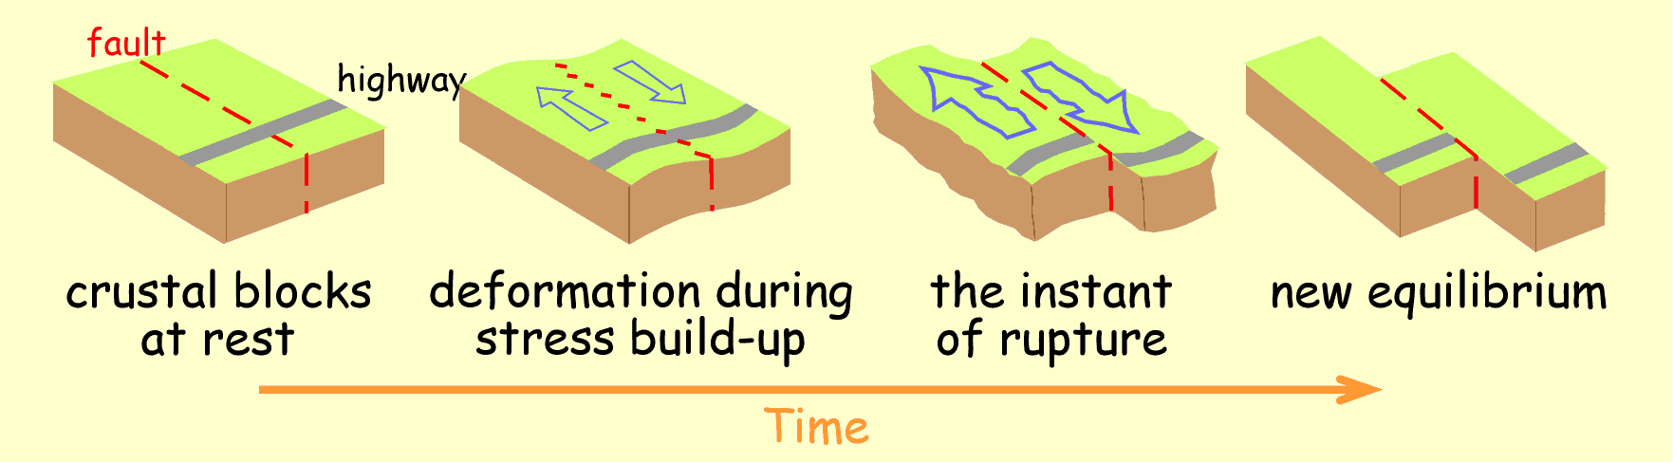
Causes: accumulated strain leads to fault rupture - the elastic rebound model

Slide 3
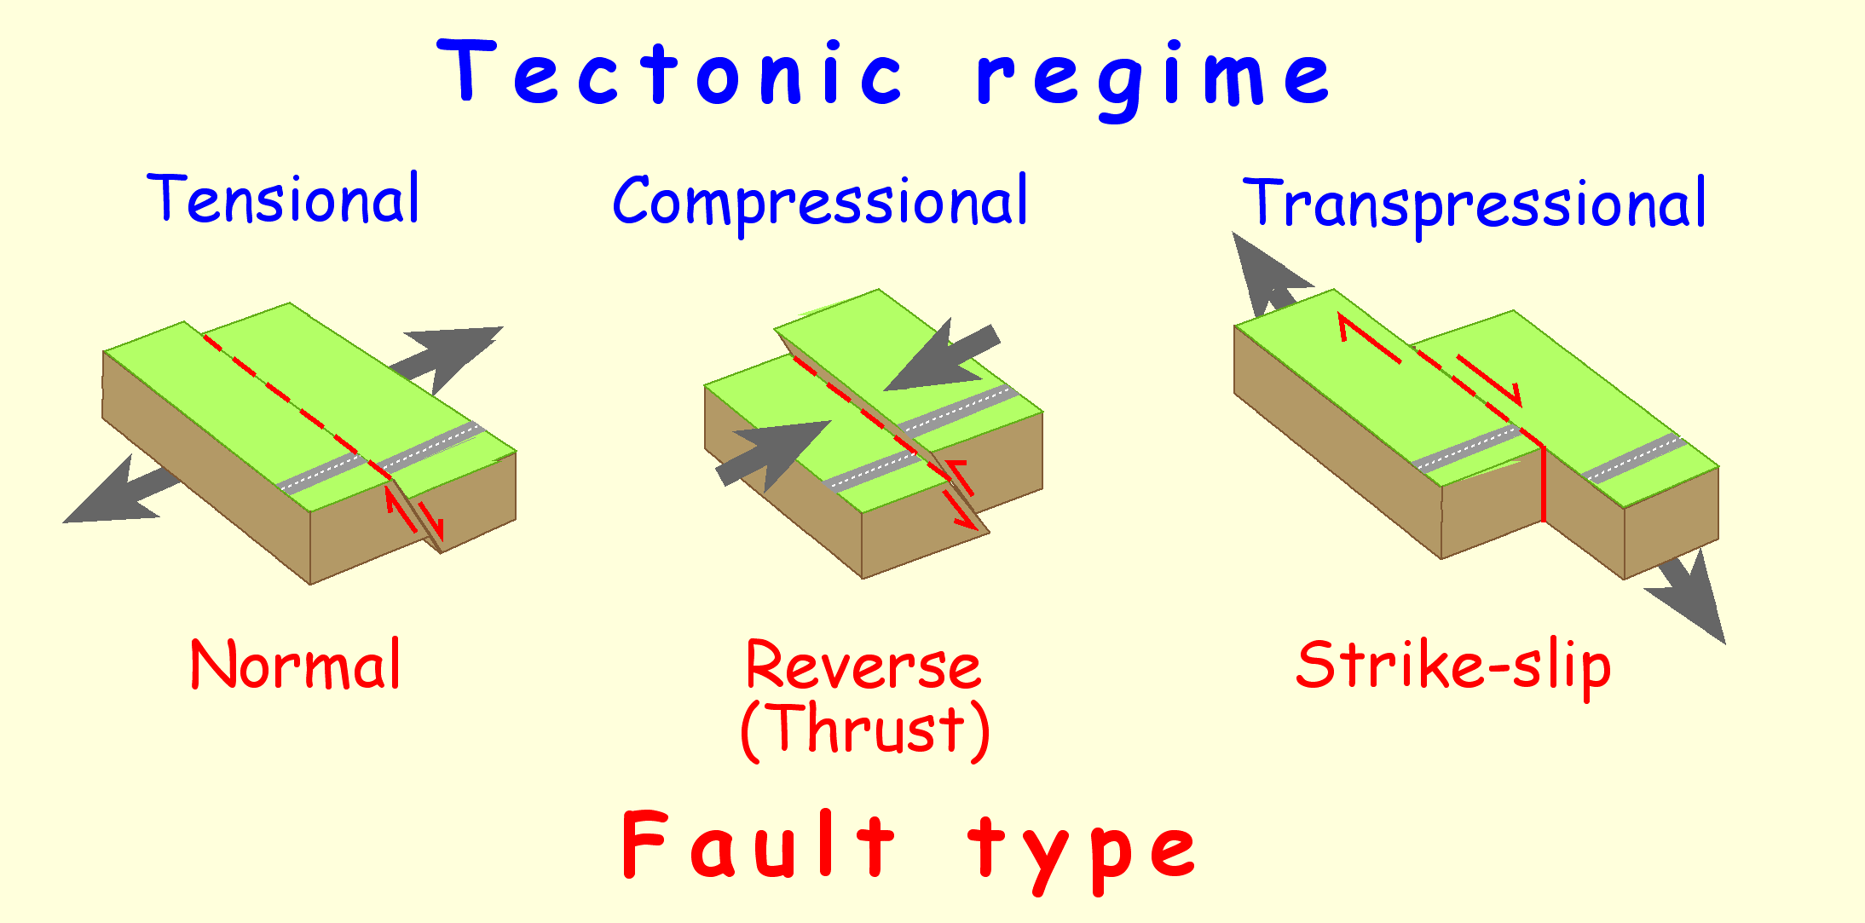
Styles of faulting

Slide 4
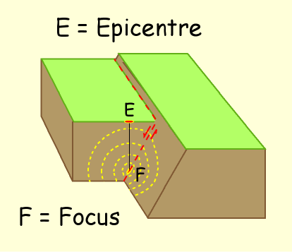
Causes: fault movement releases energy as seismic waves radiating from rupture
Seismic waves

Slide 5
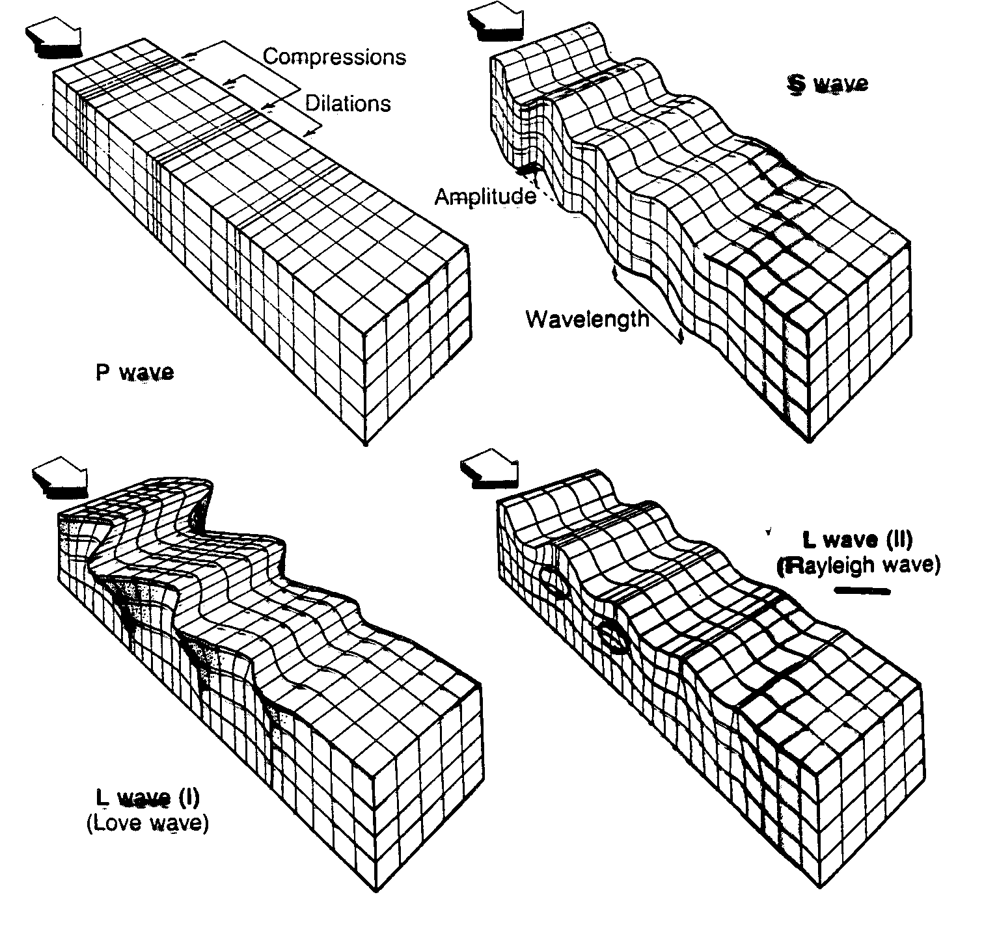
Seismic wave forms
S wave
P wave
L wave
(Rayleigh wave)
L wave
(Love wave)

Slide 6
Earthquake magnitude: scales based on seismograms
M_{L}=local (e.g. Richter scale) - based on amplitude of waves with 1s period within 600 km of epicentre.
M_{b}=body-wave (similar to above)
M_{s}=surface wave (wave periods of 20s measured anywhere on globe
M_{o}=seismic moment
M_{w}= moment magnitude

Slide 7
The Richter scale
Steps: 1. Measure the interval (in seconds) between the arrival of the first P and S waves. 2. Measure the amplitude of the largest S waves. 3. Use nomogram to estimate distance from earthquake (S-P interval) and magnitude (join points on S-P interval scale and S amplitude scale). 4. Use seismograms from at least three geographic locations to locate epicentre by triangulation.

Slide 8
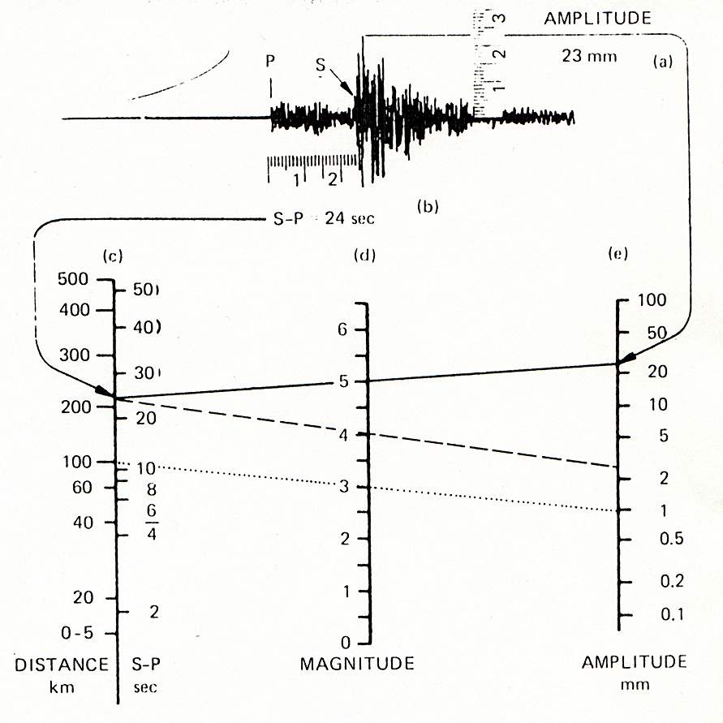
The Richter scale nomogram
2
1
Steps
3
Nomogram

Slide 9
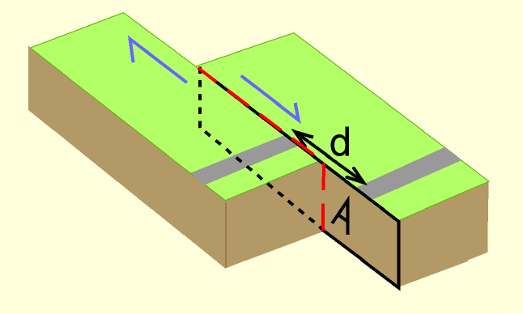
Earthquake magnitude: scales based on rupture dimensions (equivalent to energy released )
M_{o}= seismic moment. = μ * A * d, where μ is the shear modulus of rock; A is the rupture area, and d is displacement
M_{w}= moment magnitude. = 2/3 * log M_{o} - 10.7
N.B. moment scales do not saturate

Slide 10
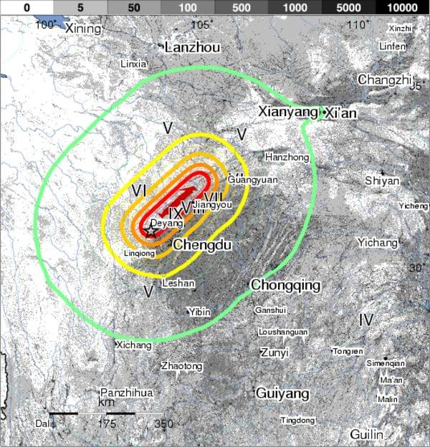
Earthquake magnitude: scales based on shaking intensity
e.g. Mercalli, Rossi-Forel, San Francisco scales MMI (=Modified Mercalli Index) I Not felt ….. VI Felt by all. Many frightened and run outdoors. Persons walk unsteadily. Pictures fall off walls. Furniture moved, trees shaken visibly.
…. XII Damage nearly total. Objects thrown into air.
Sichuan earthquake, May 12, 2008

Slide 11
Seismic hazards
Locating faults
Estimating recurrence: history and geology
Measuring relative motions and crustal deformation
Learning from analogies
Assessing probabilities

Slide 12
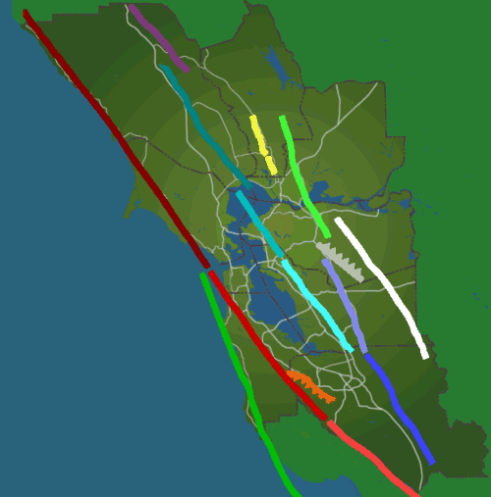
Prediction: where will the next earthquake in the Bay Area occur?
Berkeley
San Andreas
Oakland
Hayward
San Francisco
San Jose
Santa Cruz

Slide 13
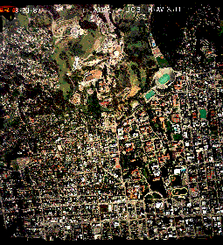
The Hayward fault runs through UC Berkeley campus (US $1 billion seismic upgrade program)
Lawrence
Livermore
UC Berkeley

Slide 14
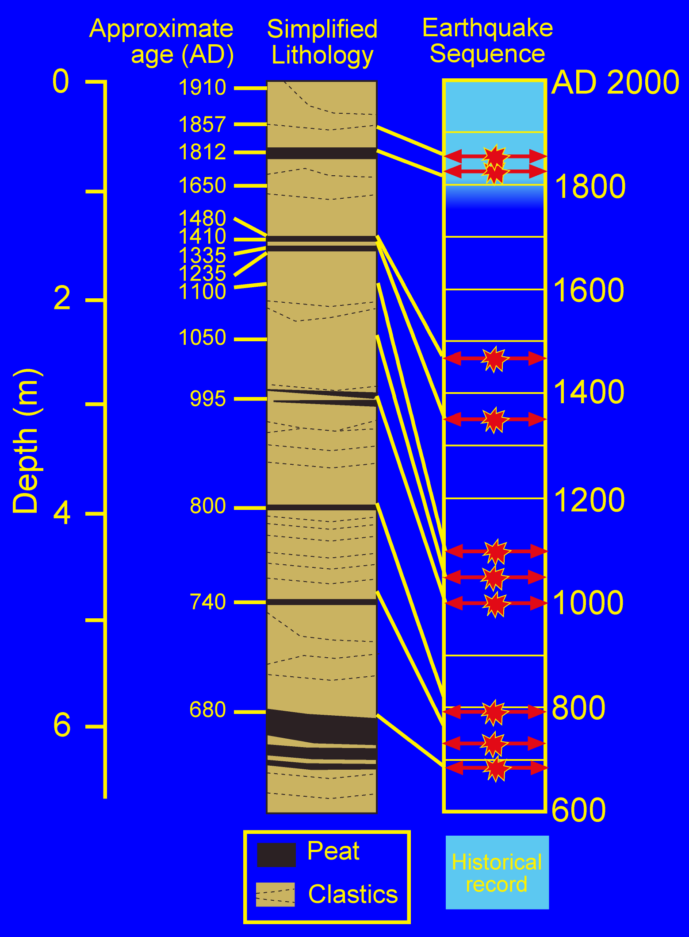
Recurrence: geological evidence e.g. Pallett Creek, CA (after Sieh, et al. 1989)

Slide 15
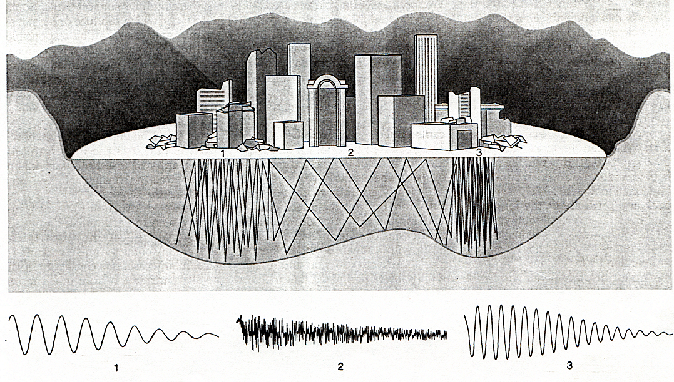
Ground motion, structural damage and basin morphology: Mexico City, 1985
Damage
heavy light heavy
body\surface
surface/body
ridge
basin
basin
periodic
random
periodic

Slide 16
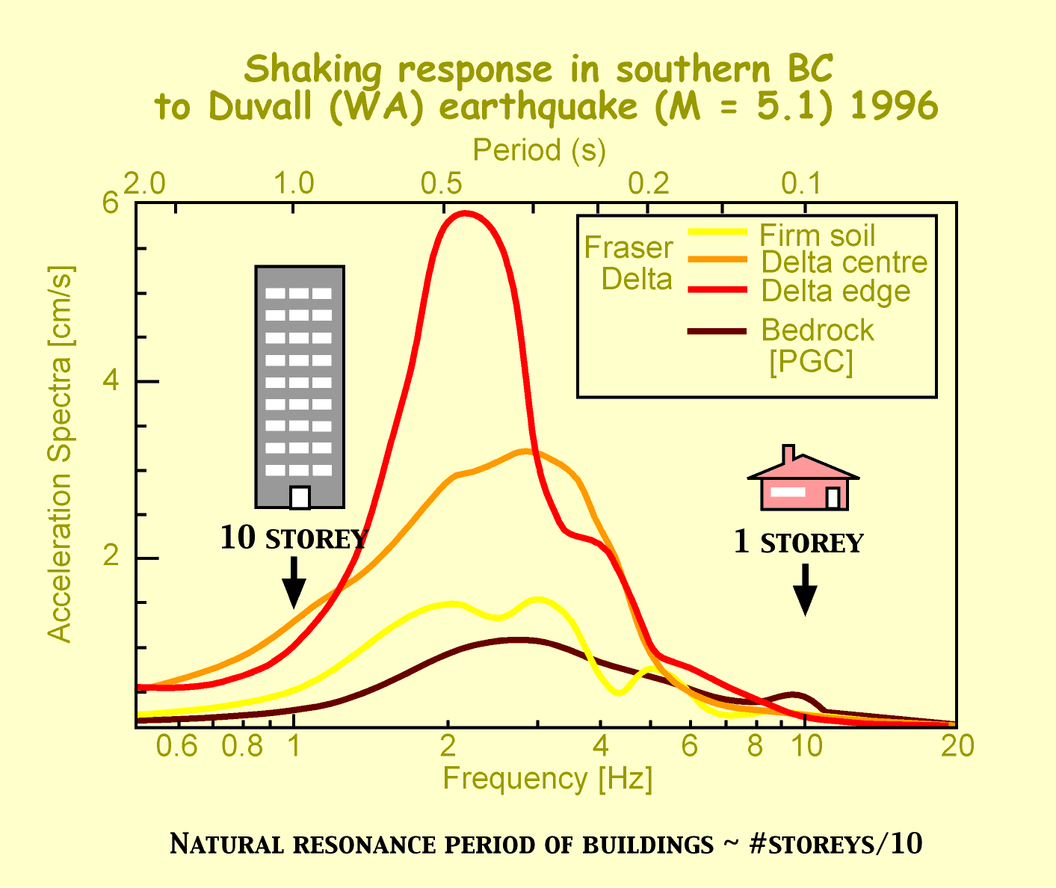

Slide 17
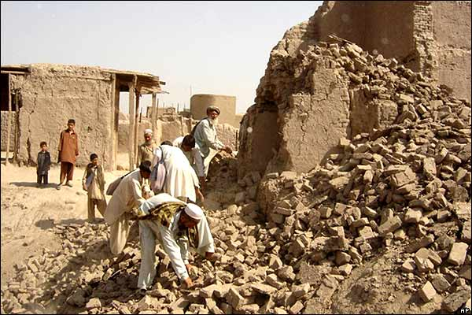
“Much of the building is done by people putting up their own houses. But they cannot afford proper materials and do not use skilled labour. There are many small kilns producing bricks but because of demand these are not fired for the 28 days needed to make them strong.”
Muzaffarabad, Pakistan (October 8, 2005 M 7.7; depth 10km)

Slide 18
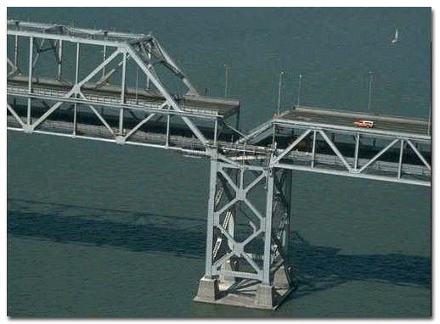
Bridge collapse Loma Prieta earthquake, CA (1989)
Notes:
Bay area Bridge

Slide 19
Preparedness (examples)
Buildings - site selection, design to code, retrofit, upgrade codes;
Strengthen bridges, dams, pipelines;
Earthquake drills - houses, schools, search & rescue;
Emergency planning - survival kits, evacuation routes, fire prevention, utility failures, communication alternatives, education

Slide 20
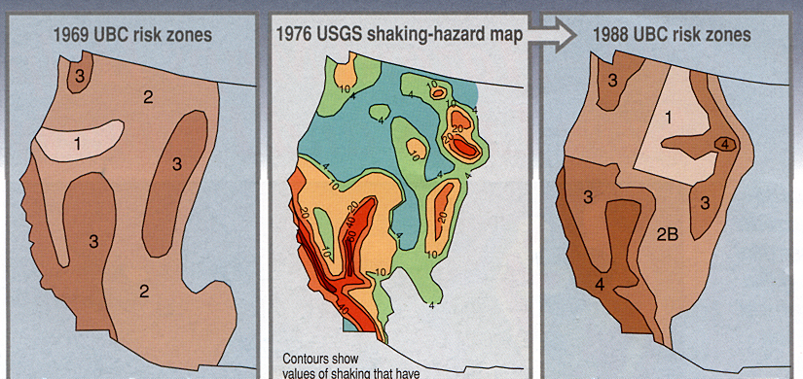
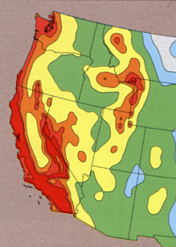
Preparedness: Modifying the building code in the western US
1969 1976 1988 1996
UBC = Uniform Building Code

Slide 21
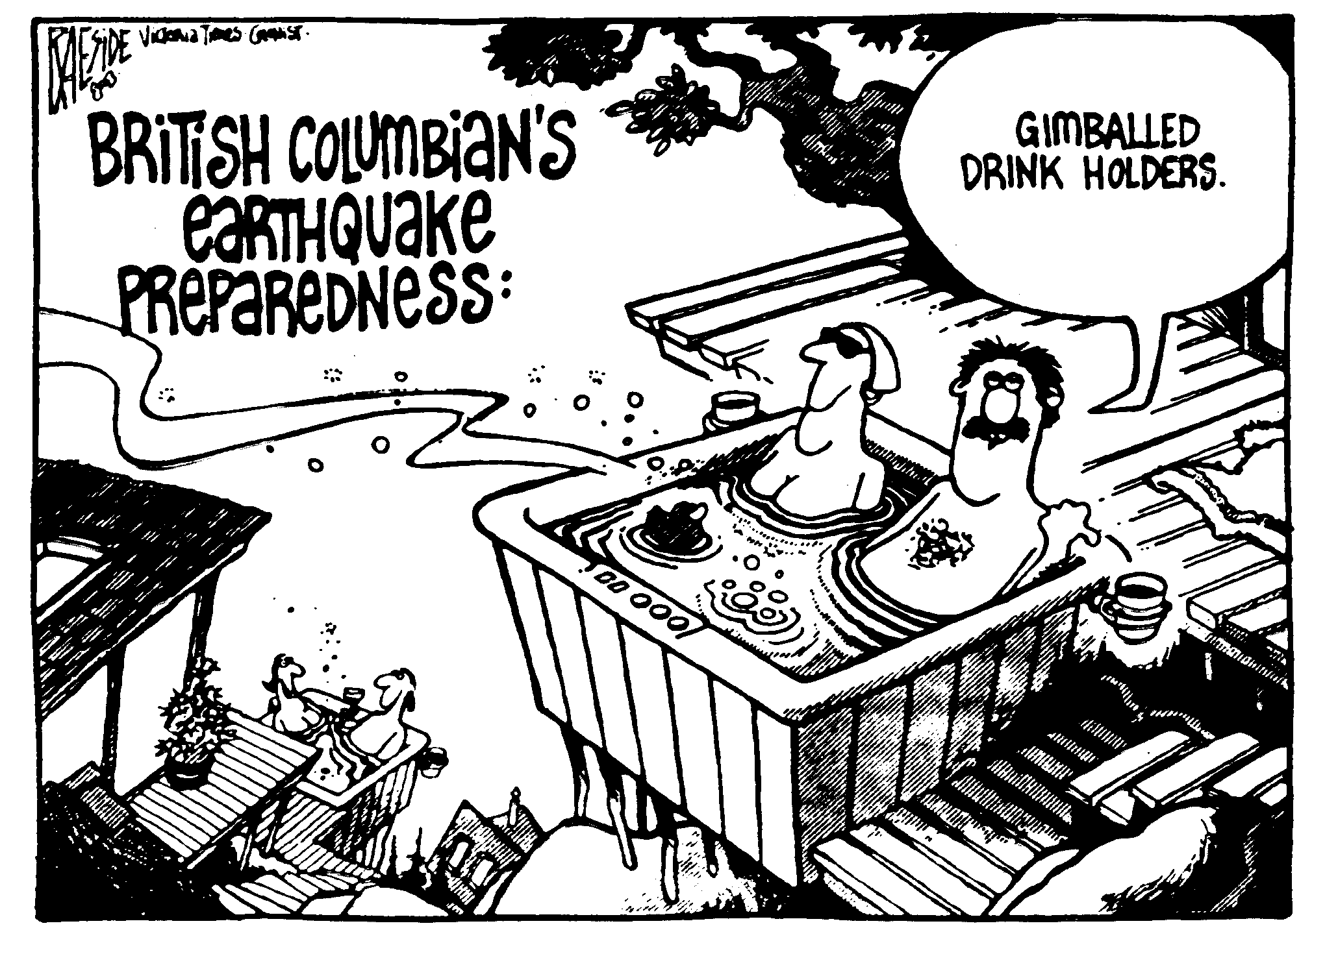
Public education?

Slide 22
Post-earthquake adjustments
Compare:
abandonment of Antigua Guatemala (mid-C18th) vs.
reconstruction of Lisbon (post-1755), San Francisco (post-1906), Kobe (post-1995).

Slide 23
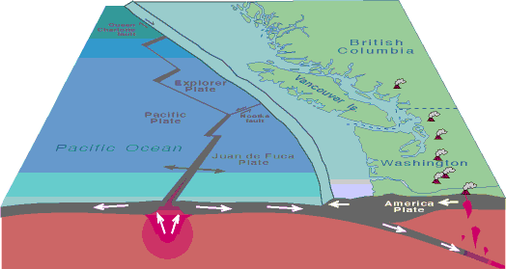
Cascadia: megaearthquakes at the plate boundary
M_{w} = 9.2?

Slide 24
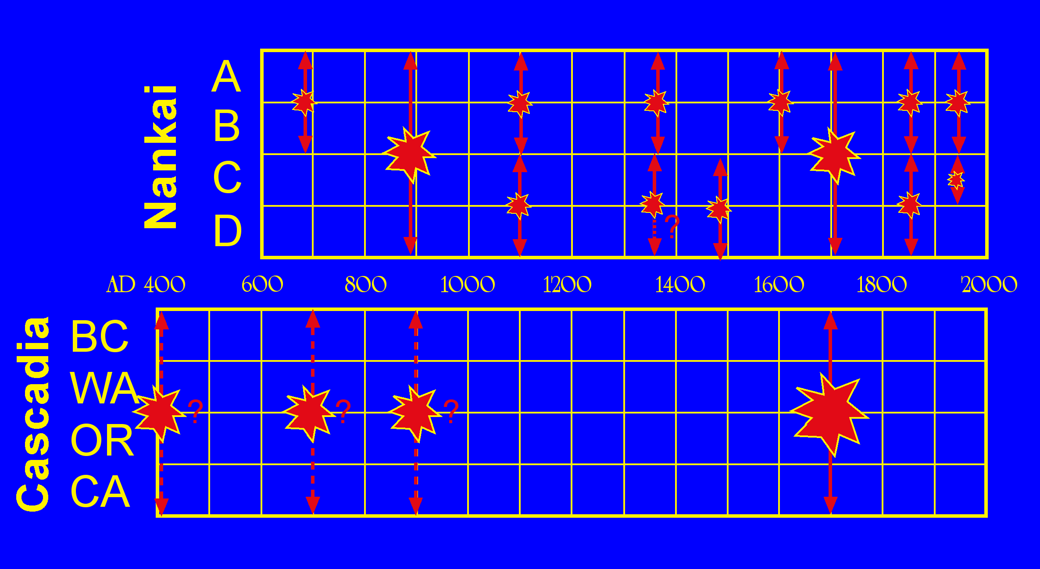
Earthquake sequences, Nankai Trough and Cascadia
or here?
S U W W? Y

